Slide 1

Department of Information Technology A.P. Shah Institute of Technology G.B.Road,Kasarvadavli, Thane(W), Mumbai-400615 UNIVERSITY OF MUMBAI Academic Year 2019-2020

Slide 2
A Project Report on Appraisal System for Educational Institutes
Submitted in partial fulfillment of the degree of Bachelor of Engineering(Sem-8) in INFORMATION TECHNOLOGY By Anagha Devade(16104011) Debashish Choudhury (16104060) Utkarsh Naik(15104048) Under the Guidance of Prof. Anagha Aher Prof. Vishal Badgujar

Slide 3
1.Project Conception and Initiation

Slide 4
An appraisal system is an integral part of any organization having salaried employees like Education institutes, banks, IT companies, etc. Through understanding and evaluating employee correctly, the enterprise not only can impel employee effectively, but also can guarantee the organization rapid and sustainable development. It is utilized to track individual contribution and performance against organizational goals. Similarly, for educational institutes, the requirements, and parameters used for evaluation are different from the ones used in other domains. A domain specific common appraisal system for Educational institutes is the need of the hour.
1.1 Abstract

Slide 5
1.2 Objectives
To optimize the process of performance evaluation.
To improve the overall teaching quality of the institute.
To make the appraisal process hassle-free.
To create a positive impact of the performance appraisal system towards the performance of the respondents in terms of commitment, skills and responsibilities.
To make the process of appraisal economical
To provide detailed analysis of the faculties’ performance to both the faculty as well as higher authorities.

Slide 6
1.3 Literature Review
Sr no. | Title | Author and Publication | Conference Name | Method | Algorithm
1 | Employee Performance Assessment in Virtual Organization using Domain-Driven Data Mining and Sentiment Analysis. | Tejshree D. Chungade and Prof. Shweta Kharat, 2017 | IEEE, International Conference on Innovations in information Embedded and Communication Systems (ICIIECS),2017 | 360 degree feedback | K means clustering
2 | HiSPEED: A System for Mining Performance Appraisal Data and Text. | Girish Keshav Palshikar, Manoj Apte, Sachin Pawar, Nitin Ramrakhiyani, 2017 | IEEE, International Conference on Data Science and Advanced Analytics,2017 | Rating Based System | Naïve Bayes classification
3 | A Scrutiny of Teachers’ Pursuance Using Classification Techniques | V. Shanmugarajeshwari, R Lawrence, 2017 | IEEE International Conference on Intelligent Techniques in Control, Optimization and Signal Processing,2017 | Student feedback and result | Decision Tree, Naïve Bayes
4 | Educational data mining that supports quality teaching: How to create a culture of data in educational policies. | NA, 2016 | IEEE Global Engineering Education Conference (EDUCON),2016 | In-classroom feedback | K Star, Random Tree
5 | 720 Degree performance appraisals: An effective tool to efficiency of modern employees | J. George, 2016 | IEEE International Conference on Electrical, Electronics, and Optimization Techniques (ICEEOT),2016 | 720 degree feedback | K means clustering, Decision Tree

Slide 7
1.4 Problem Definition
Educational institutes traditionally rely on pen-paper method to manually get data, generate performance score or else use paid software.There is no common portal for staff appraisal as each institute may consider different parameters.
Lack of documentation of problems becomes a problem itself. This means employers are open to wrongful termination claims if an employee has a record of good reviews but is later fired for poor performance seemingly out of nowhere .
Having an official performance review process can actually hinder timely feedback the rest of the year if the process is carried out without proper planning.

Slide 8
1.5 Scope
The appraisal system will not only evaluate employee's performance but also escalate the educational institute's growth and increase it's teaching and overall quality
Our appraisal system will also save cost of the educational institutes and the evaluation process can be changed according to criteria of different institutes .
It also helps the professor's to track their growth on individual level.
Our project can make a traditionally manual appraisal system online.

Slide 9
1.6 Technology stack
1) Hardware:
Can run on any device with browsing capabilities.
Example: Desktops, Laptops, Smartphones, etc.
2) Software:
Frontend: Node Templates(handlebars), Materialize CSS
Backend: NodeJS, MongoDB.

Slide 10
1.7 Benefits for environment & Society
Paper-pen work is omitted
Cost efficient
Growth Evaluation
Trees are saved due to omission of pen-paper work.

Slide 11
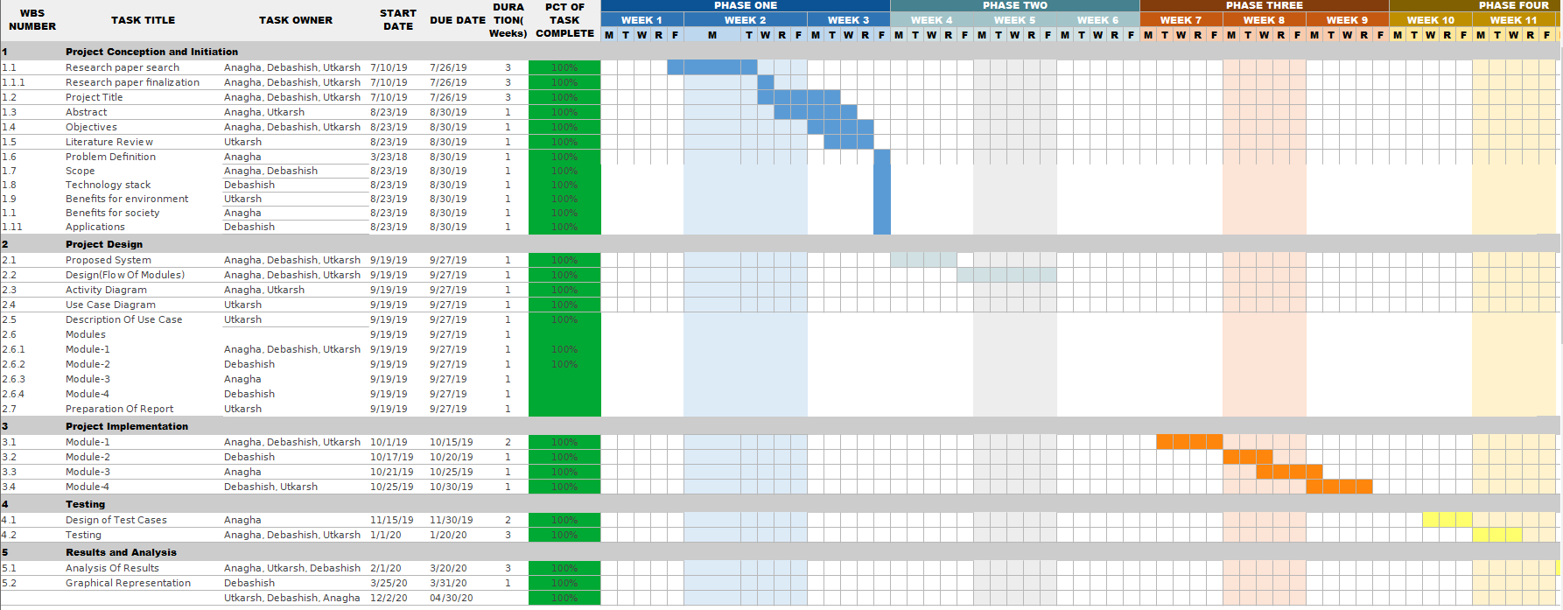
1.8 Project Timeline Chart

Slide 12
2. Project Design

Slide 13
2.1 Proposed System
Our proposed system be a web application developed using NodeJS and MongoDB at the backend and Node Templates in the frontend.
Our proposed system will make the performance evaluation process online. Staffs will fill the form online and also have an option to upload certificates if required. On the basics of the form filled each staff will be graded marks.
The self appraisal marks after approval by the HOD along with confidential score will help the management take the final appraisal decisions. .

Slide 14
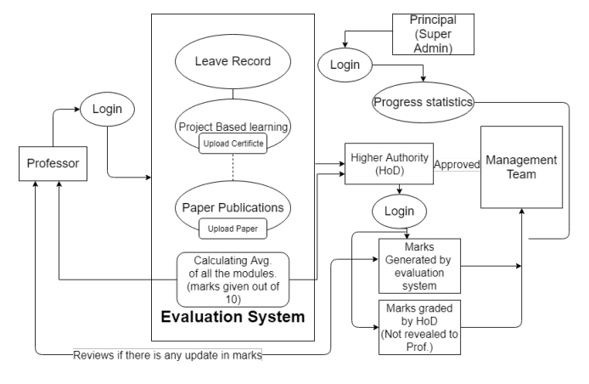
2.2 Design(Flow Of Modules)

Slide 15
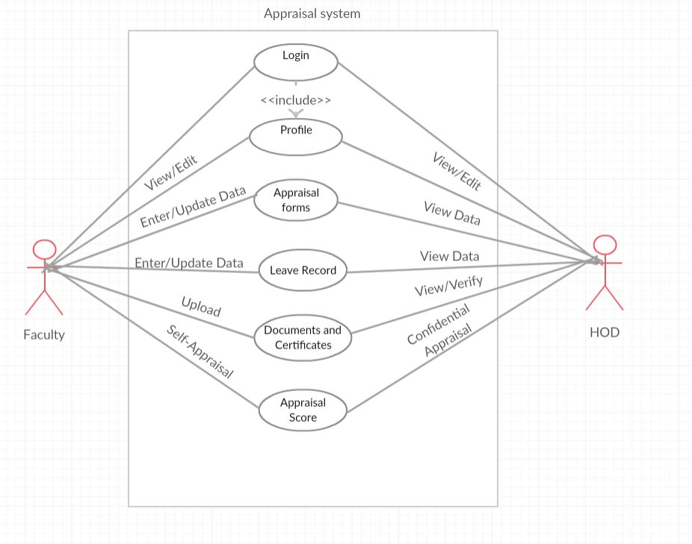
2.3 Description Of Use Case

Slide 16
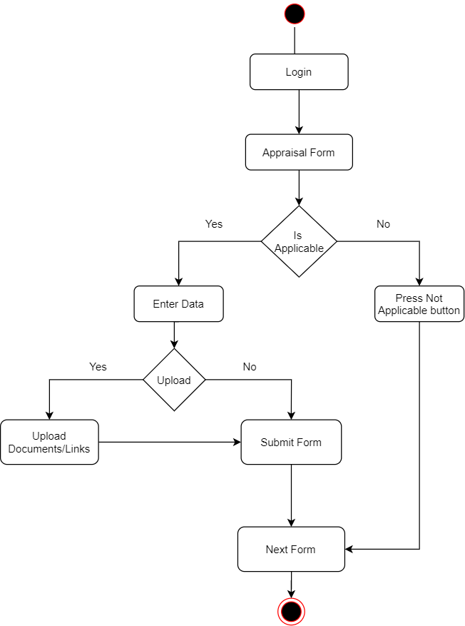
2.4 Activity diagram

Slide 17
2.6 Module-1
Our module consist of Academic Performance,Regularity and Attendance,Annexure 1
The Academic Performance consists of various forms such as Teaching Load,Teaching Assistance, Additional Teaching Techniques etc.It will overall evaluated on basis of 40 marks.
Next is Regularity and Attendance which consist of post sanctioned and pre sanctioned leaves and it will be evaluated on basis of 10 marks.
Next is Annexure 1 which focuses professor's contribution to the participation in college or departmental level and it consists of total 19 forms and it will evaluated on basis of 25 marks.

Slide 18
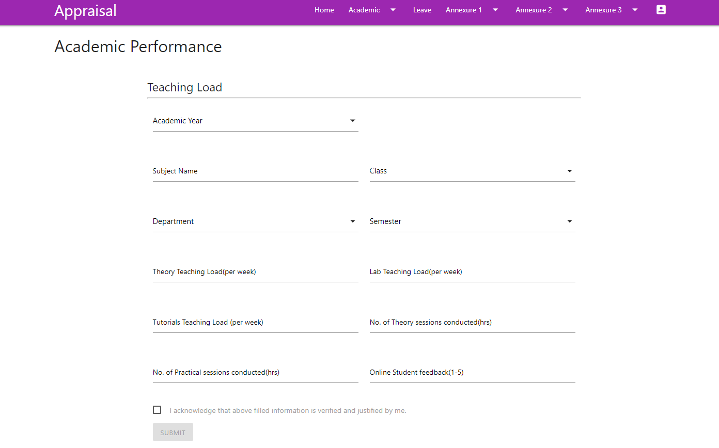
Module-1 (continued)

Slide 19
Module-2
The Module-2 consists of Annexure 2
In Annexure 2 the criteria is based self-improvement initiatives which includes aspects in developing personal interest or any action taken for personal growth.
It has total 7 forms and it will be evaluated on basis of total 15 marks.

Slide 20
Module-3
The Module-3 consist of Annexure 3
Annexure 3 is mainly based and focused on professor representing college in external environment and also it has criteria for representing talents at external level or any project competition.It is also based on any contribution at university level
Annexure 3 has total 5 forms and it will be based on criteria of 10 marks.

Slide 21
Module-4
This module is sub-divided into two parts:
Part A:
Here the admin access page is implemented where in the the admin/HOD will login and get a list of all the the faculties who are registered.
The admin/HOD will have the two option either to review the faculty’s self appraisal form or else fill up the confidential form for that particular faculty.
Part B:
Here the faculty will review the entire filled-up form and accordingly do any required changes if any and accordingly changes will be saved.
If faculty doesn’t have any changes a final submit is done.

Slide 22
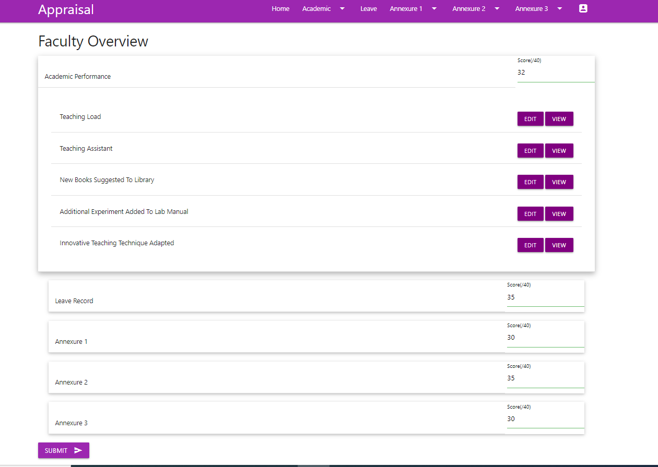
Module-4(continued)

Slide 23
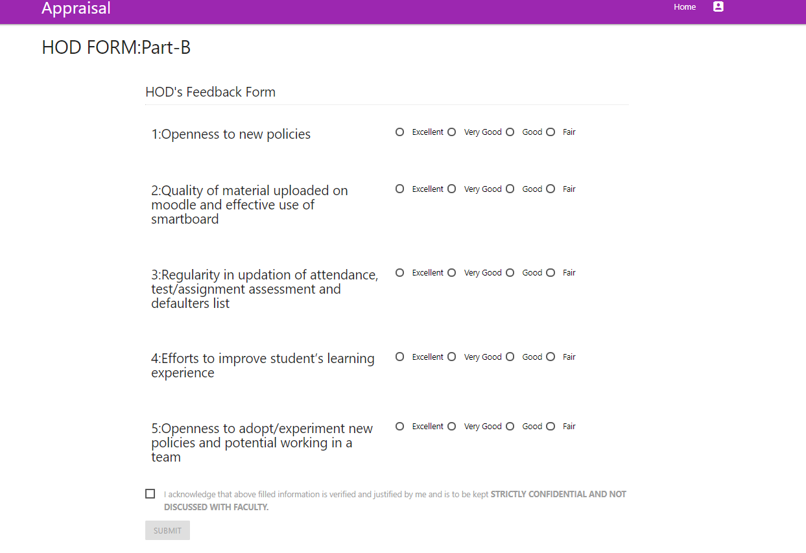
Module-4(continued)

Slide 24
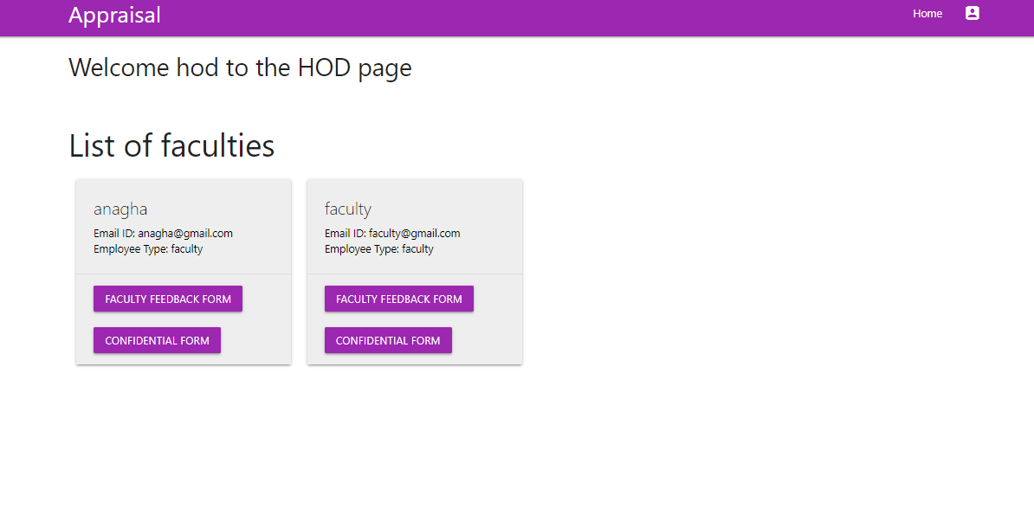
Module-4(continued)

Slide 25
2.7 Conclusion
Our proposed system will be a progressive web-app which will make the Staff appraisal process fully online and hassle free. Along with elimination of physical forms, it will also ease the verification process (by HOD or higher authorities). Also, educational institutes will not have to invest a hefty amount for developing a customized appraisal system as our proposed system will provide the same facilities. This is cost effective as well as saves time compare to the existing system.

Slide 26
The appraisal system will not only evaluate employee's performance but also escalate the educational institute's growth and increase it's teaching and overall quality
Our appraisal system will also save cost of the educational institutes and the evaluation process can be changed according to criteria of different institutes .
It also helps the professor's to track their growth on individual level based on the previous records which will serve as in input to data analysis.
Based on the data analysis a new chart/graph can be generated which will help the educational institute to take further important decisions.
2.8 Future Scope

Slide 27
2.9 Paper Publication Details
[1] Utkarsh Naik,Anagha Devade,Debashish Choudhary, Anagha Aher, Vishal Badgujar, "Study on Feasibility of Uniform Appraisal System", 2020 6th IEEE International Conference on Emerging Trends in Information Technology and Engineering (ic-ETITE), 24-25 February 2020.
[2 ]Utkarsh Naik,Anagha Devade, Debashish Choudhary, Anagha Aher, Vishal Badgujar, “Study on Semi Automation in Uniform Faculty Appraisal System”
2020 6th IEEE International Conference on Advanced Computing & Communication Systems (ICACCS),6-7 March 2020

Slide 28
2.10 References
[1]Tejshree D. Chungade and Prof. Shweta Kharat, “Employee Performance Assessment in Virtual Organization using Domain-Driven Data Mining and Sentiment Analysis.”, IEEE, International Conference on Innovations in information Embedded and Communication Systems (ICIIECS), 2017.
https://ieeexplore.ieee.org/document/8276093
[2] Girish Keshav Palshikar, Manoj Apte, Sachin Pawar, Nitin Ramrakhiyani., “HiSPEED: A System for Mining Performance Appraisal Data and Text.”, IEEE, International Conference on Data Science and Advanced Analytics, 2017. https://ieeexplore.ieee.org/document/8259809
[3] V. Shanmugarajeshwari, R Lawrence, “A Scrutiny of Teachers’ Pursuance Using Classification Techniques”, IEEE International Conference on Intelligent Techniques in Control, Optimization and Signal Processing, 2017. https://ieeexplore.ieee.org/document/8303123
[4] “Educational data mining that supports quality teaching: How to create a culture of data in educational policies”, IEEE Global Engineering Education Conference (EDUCON), 2016. https://ieeexplore.ieee.org/document/7474664
[5] J. George, “720 Degree performance appraisals: An effective tool to efficiency of modern employees”, IEEE International Conference on Electrical, Electronics, and Optimization Techniques (ICEEOT), 2016. https://ieeexplore.ieee.org/document/7755635

Slide 29
Thank You

